Slide 1
APOLOGETICS
IN ONE LESSON
almost
Ai1L.net
Lesson 3
Ambassadors for Christ

Slide 2
Key Takeaways (review)
1
Time on “pre-evangelism” is time well spent; give yourself credit even if all you do is ask some questions
2
Getting to the “call-to-action” in every conversation is not required (and in some cases, not a good idea)

Slide 3
IDEA IN BRIEF
What?
Recognize how much our approach matters (in addition to the facts)
Why?
So that we use an artful and attractive approach that makes our message more persuasive
How?
By discussing the attributes of an ambassador and how we can use them

Slide 4
What are the attributes of a good ambassador?
1

Slide 5
What is the significance of the Apostles being called “ambassadors for Christ”?
2

Slide 6
Consider examples of Paul being an ambassador
3

Slide 7
Describe 1 Peter 3:15 in its context
4

Slide 8
“But set Christ apart as Lord in your hearts and always be ready to give an answer to anyone who asks about the hope you possess. But respond with gentleness and respect”
1 Peter 3:15

Slide 9
“keeping a good conscience, so that those who slander your good conduct in Christ may be put to shame when they accuse you.”
1 Peter 3:16

Slide 10
“Apologetics needs to focus on the ‘how’ of good apologetics, as much as the ‘what.’”
CASEY CHALK Crisis Magazine

Slide 11
Consider examples from Jesus’ life that illustrate him being an ambassador
5

Slide 12
What are some other examples of people who built bridges to others?
6

Slide 13
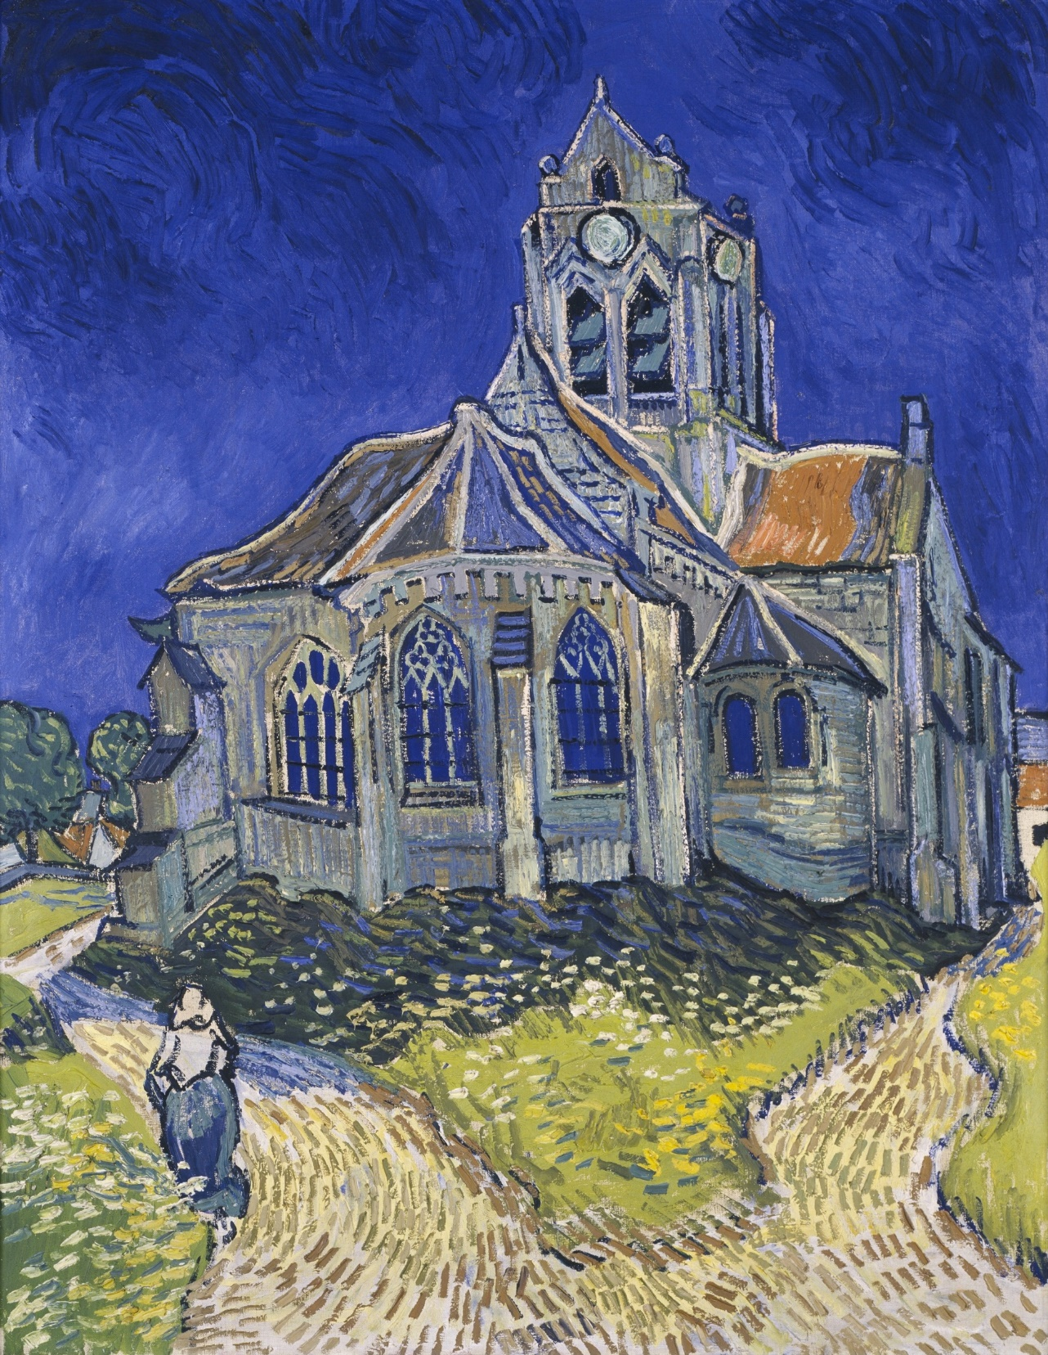
The Church at Auvers
Vincent van Gogh (June 1890)

Slide 14
List some things that Christians can do that get in the way of others becoming disciples?
7

Slide 15
Key Takeaways
1
1 Peter 3:15 (“the Apologist’s verse”) emphasizes character over case-making
2
Representing God’s character matters as much as representing the facts
3
A good ambassador uses an artful method in addition to good facts

